Slide 1


HTML Tables

Slide 2
Table of Contents
HTML Tables
Simple Tables
Data cells and Header cells
Complete HTML Tables
Nested Tables
Complex tables
Cell Spacing and Padding
Column and Row Span

Slide 3
HTML Tables
Tables represent tabular data
A table consists of one or several rows
Each row has one or more columns
Tables are comprised of several core tags:
<table></table>: begin/end table definition
<tr></tr>: create a table row
<td></td>: create tabular data (cell)
Tables should not be used for layout
Use CSS floats and positioning styles instead

Slide 4
Simple HTML Tables – Example
<table cellspacing="0" cellpadding="5">
<tr>
<td><img src="ppt.gif"></td>
<td><a href="lecture1.ppt">Lecture 1</a></td>
</tr>
<tr>
<td><img src="ppt.gif"></td>
<td><a href="lecture2.ppt">Lecture 2</a></td>
</tr>
<tr>
<td><img src="zip.gif"></td>
<td><a href="lecture2-demos.zip">Lecture 2 - Demos</a></td>
</tr>
</table>

Slide 5
Data Cells and Header Cells
Two kinds of cells in HTML tables
Data cells – containing the table data
Header cells – used for the column names or some more important cells
Why two kinds of cells?
Used to semantically separate the cells
<tr>
<th>Full Name</th> <th>Mark</th>
</tr>
<tr>
<td>Doncho Minkov</td> <td>Very good (5)</td>
</tr>
<tr>
<td>Georgi Georgiev</td> <td>Excellent (6)</td>
</tr>

Slide 6
Complete HTML Tables With Header, Footer and Body

Slide 7
Complete HTML Tables
Table rows split into three semantic sections: header, body and footer
<thead> denotes table header and contains <th> elements, instead of <td> elements
<tbody> denotes collection of table rows that contain the very data
<tfoot> denotes table footer but comes BEFORE the <tbody> tag
<colgroup> and <col> define columns (used to set column widths)

Slide 8
Complete HTML Table: Example
<table>
<colgroup>
<col style="width:100px" /><col />
</colgroup>
<thead>
<tr><th>Column 1</th><th>Column 2</th></tr>
</thead>
<tfoot>
<tr><td>Footer 1</td><td>Footer 2</td></tr>
</tfoot>
<tbody>
<tr><td>Cell 1.1</td><td>Cell 1.2</td></tr>
<tr><td>Cell 2.1</td><td>Cell 2.2</td></tr>
</tbody>
</table>

Slide 9
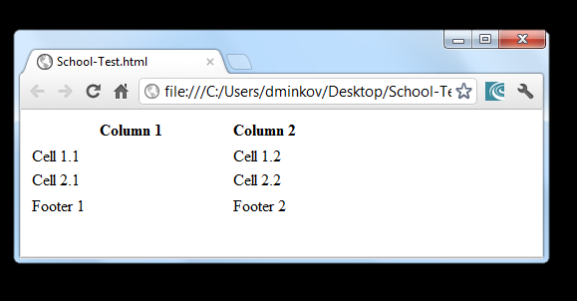
Complete HTML Table: Example
<table>
<colgroup>
<col style="width:100px" /><col />
</colgroup>
<thead>
<tr><th>Column 1</th><th>Column 2</th></tr>
</thead>
<tfoot>
<tr><td>Footer 1</td><td>Footer 2</td></tr>
</tfoot>
<tbody>
<tr><td>Cell 1.1</td><td>Cell 1.2</td></tr>
<tr><td>Cell 2.1</td><td>Cell 2.2</td></tr>
</tbody>
</table>
Although the footer is before the data in the code, it is displayed last

Slide 10
Nested Tables Tables in Tables in Tables in Tables…

Slide 11
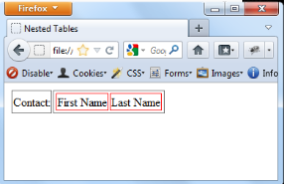
Nested Tables
Table cells (<td>) can contain nested tables (tables within tables):
<table>
<tr>
<td>Contact:</td>
<td>
<table>
<tr>
<td>First Name</td>
<td>Last Name</td>
</tr>
</table>
</td>
</tr>
</table>

Slide 12
Complex Tables With Padding, Spacing and Stuff

Slide 13
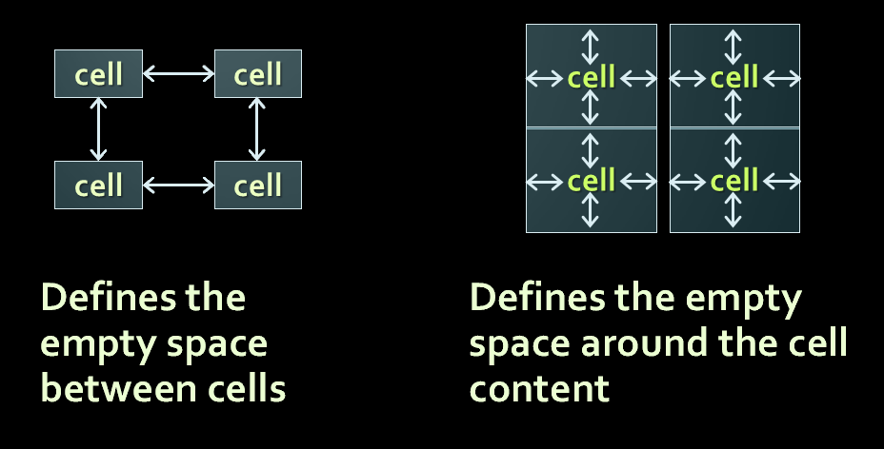
Cell Spacing and Padding
cell spacing
cell padding

Slide 14
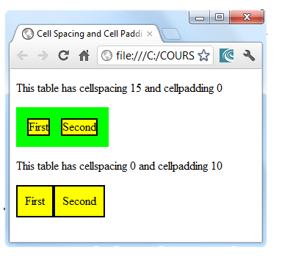
Cell Spacing and Padding – Example
<html>
<head><title>Table Cells</title></head>
<body>
<table cellspacing="15" cellpadding="0">
<tr>
<td>First</td>
<td>Second</td>
</tr>
</table>
<br/>
<table cellspacing="0" cellpadding="10">
<tr>
<td>First</td>
<td>Second</td>
</tr>
</table>
</body>
</html>

Slide 15
Row and Column Spans How to Make a Two-Cells Column or Row?

Slide 16
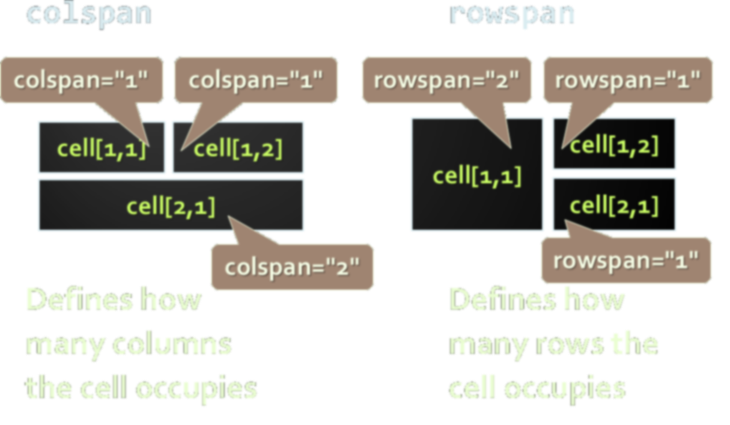
Column and Row Span

Slide 17
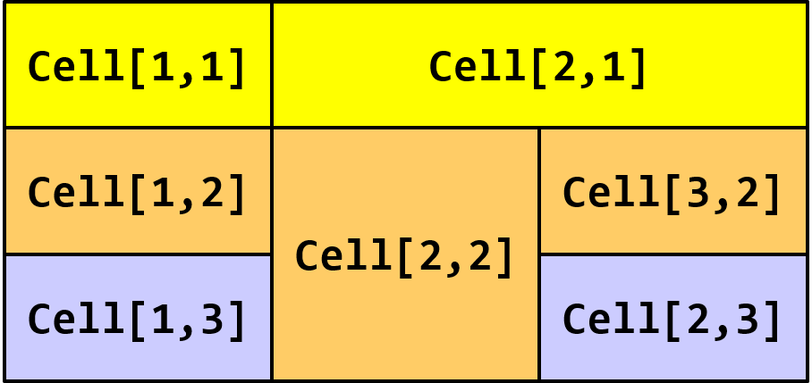
Column and Row Span – Example -->
<table cellspacing="0">
<tr class="1">
<td>Cell[1,1]</td>
<td colspan="2">Cell[2,1]</td>
</tr>
<tr class="2">
<td>Cell[1,2]</td>
<td rowspan="2">Cell[2,2]</td>
<td>Cell[3,2]</td>
</tr>
<tr class="3">
<td>Cell[1,3]</td>
<td>Cell[2,3]</td>
</tr>
</table>

